Slide 1


Python MySQL Connectivity

Slide 2
Before we start let us know bit about MySQL
MySQL is the most popular Open Source Relational SQL Database Management System.
FEATURES
It is written in C and C++
MySQL is quicker than other databases so it can work well even with the large data set.
MySQL supports many operating systems with many languages like PHP, PERL, C, C++, JAVA, etc.
MySQL uses a standard form of the well-known SQL data language.
MySQL is used for many small and big businesses.
MySQL is an open-source database, so It is available free of cost

Slide 3

To download MySQL
Visit MySQL official website http://www.mysql.com/downloads/
Choose the version number for MySQL community server which you want.

Slide 4
To download MySQL Python Connector
MySQL Python Connector is used to access the MySQL database from Python, you need a database driver. MySQL Connector/Python is a standardized database driver provided by MySQL.
Step 1: Open Command window
Step2 : type pip install mysql-connector

Slide 5
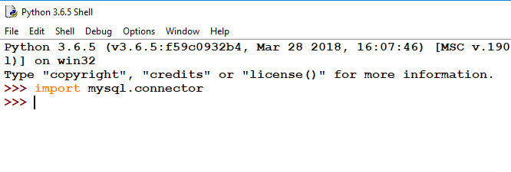
Now, to check whether mysql-connector is installed/working properly-
Open Python IDLE
Type import mysql
3. If no error occurs, it means mysql-connector is working properly

Slide 6
Steps to connect a python application to our MySQL database
Import mysql.connector module
Create the connection object.
Create the cursor object
Execute the query

Slide 7
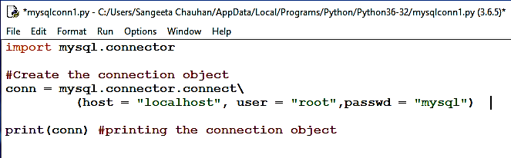
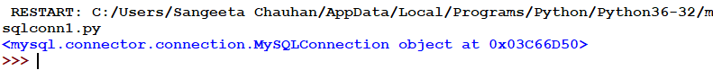
Creating the connection : connect () method
Pass the database details like HostName, username, and the database password in the method call. The method returns the connection object.
Syntax :
ConnObject = mysql.connector.connect
(host = <hostname>, user = <username> , passwd = <password> )

Slide 8
Cursor in Python
Cursors are created by the connection.cursor() method : they are bound to the connection for the entire lifetime of the program and all the commands are executed in the context of the database session wrapped by the connection.
<cur_obj> = conn.cursor()
Note : We need cursor to execute our MySQL Queries

Slide 9

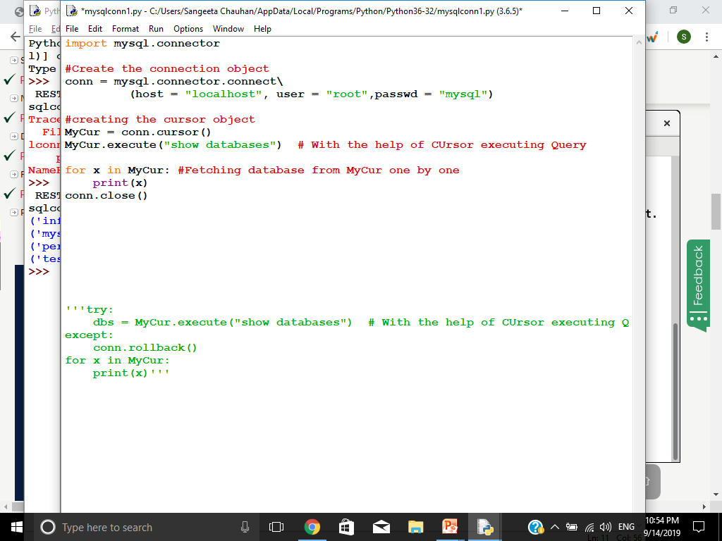
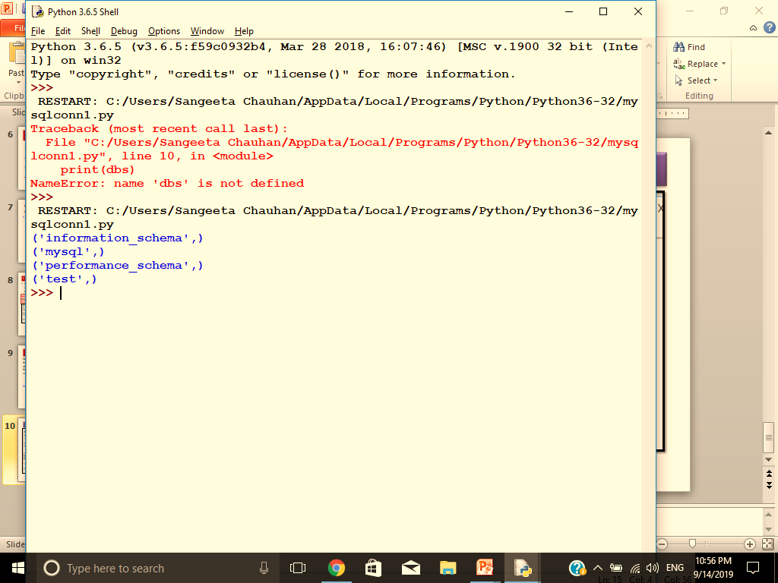
To display list of available databases in MySQL
With the help of execute () one can run any MySQL query
Showing list of databases

Slide 10
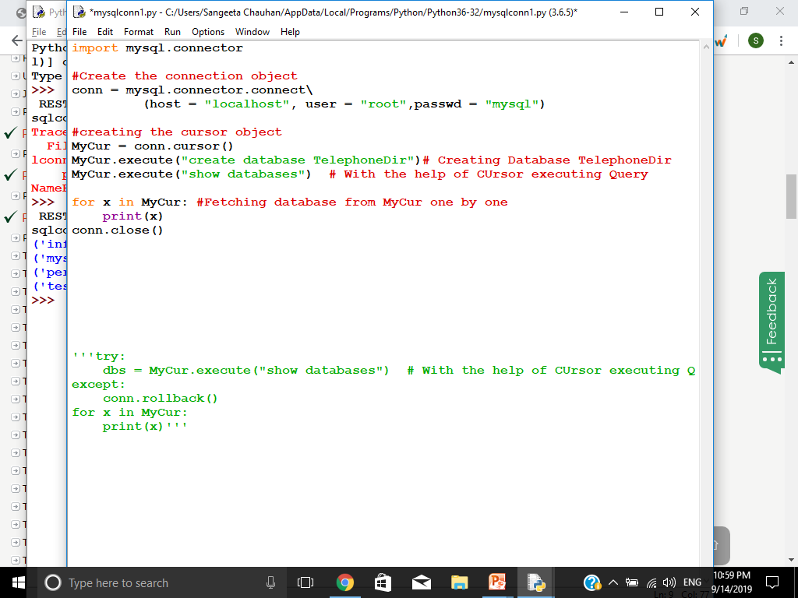
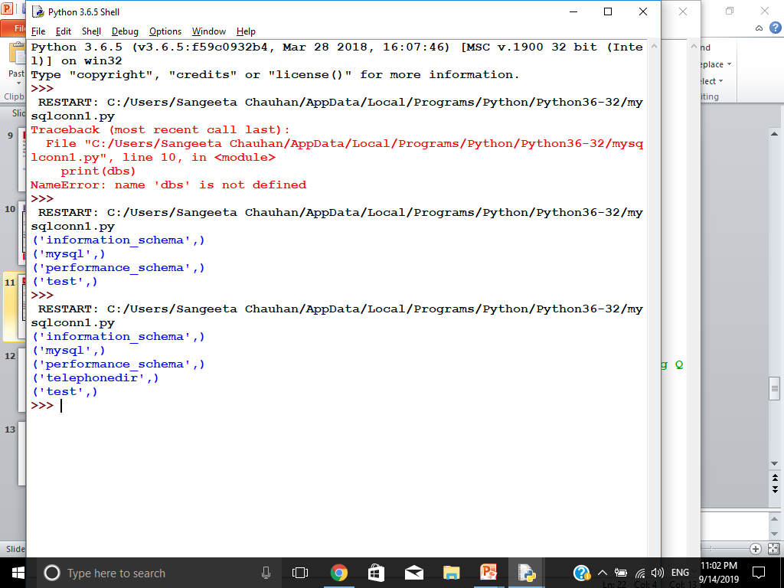
We can also create our database through python
Creating Database
See a newdatabase telephonedir is created
output

Slide 11
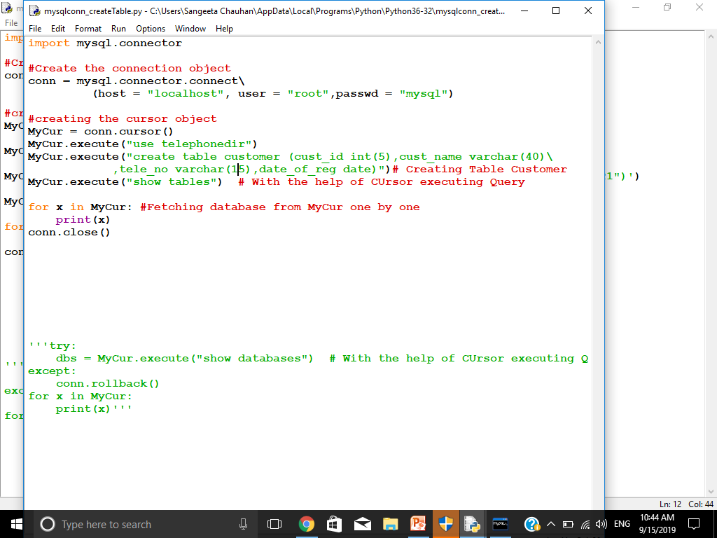
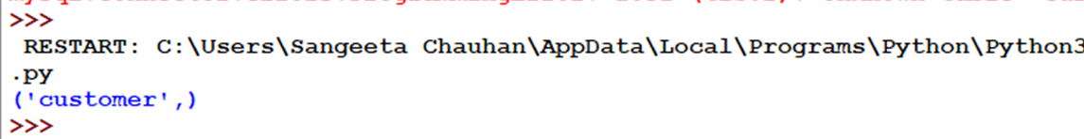
Now , lets create a table ‘customer’
Creating table
Displaying list of tables
OUTPUT

Slide 12
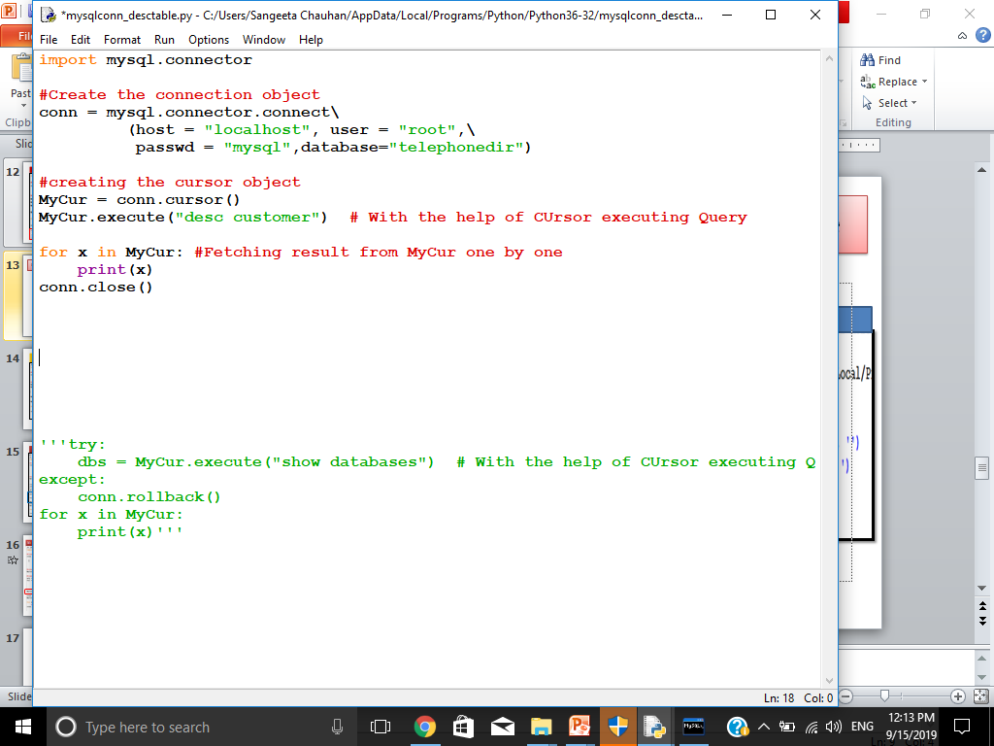
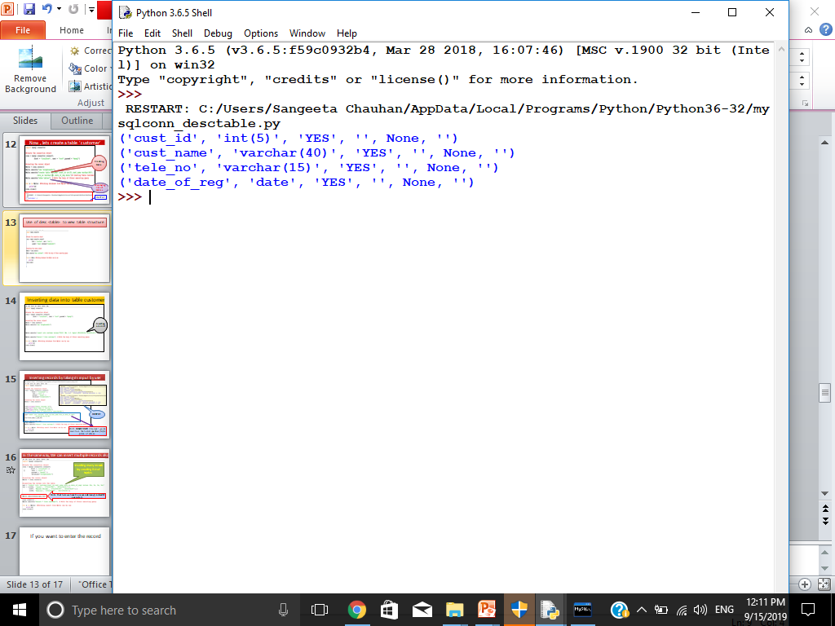
Use of desc <table> to view table structure
OUTPUT

Slide 13
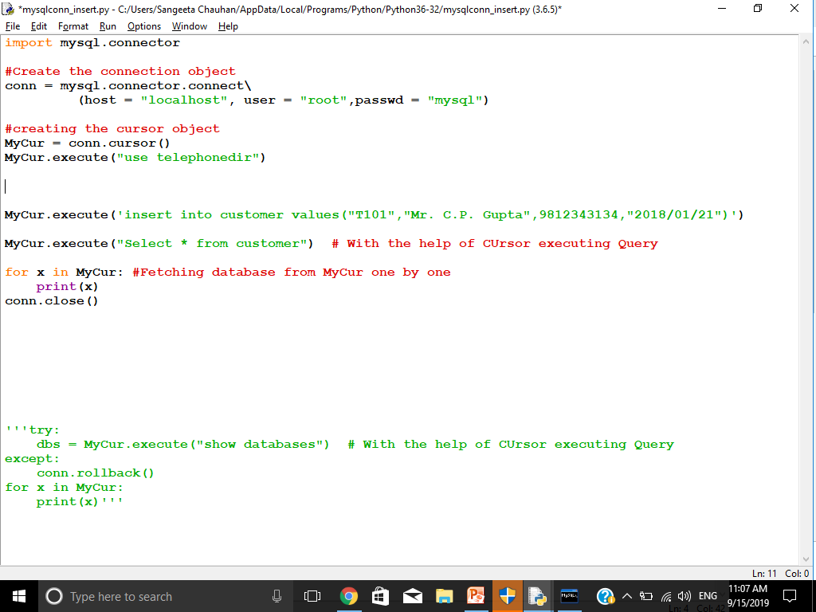
Inserting data into table customer
Inserting a record

Slide 14
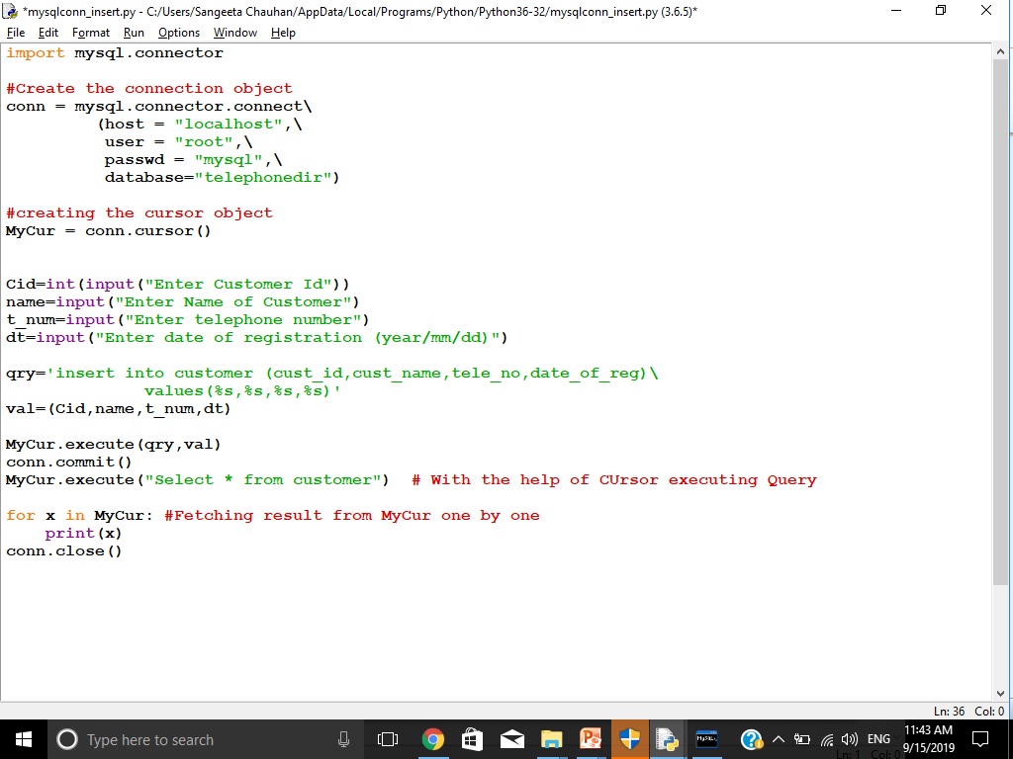
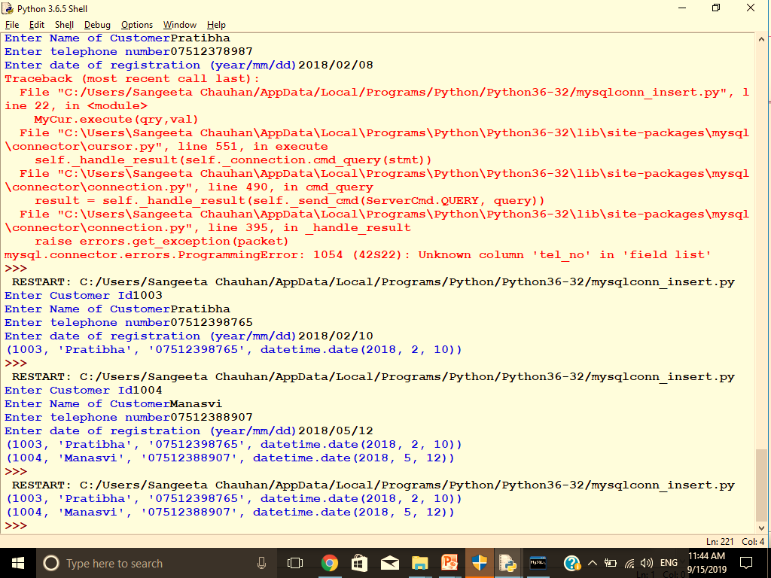
Inserting records by taking its input by user
OUTPUT
With INSERT INTO statement, we can mention the format specifier (%s) in place of values.

Slide 15
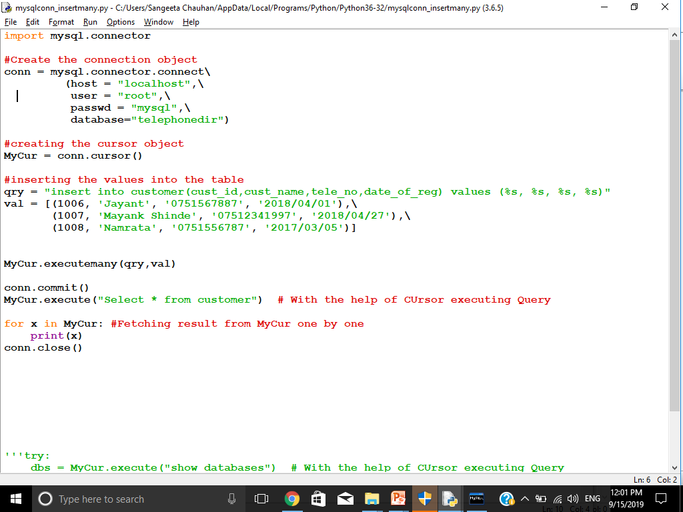
In the same way, We can insert multiple records also
Inserting many records by creating list of tuples
Note that here we have to use executemany() instead of execute()

Slide 16
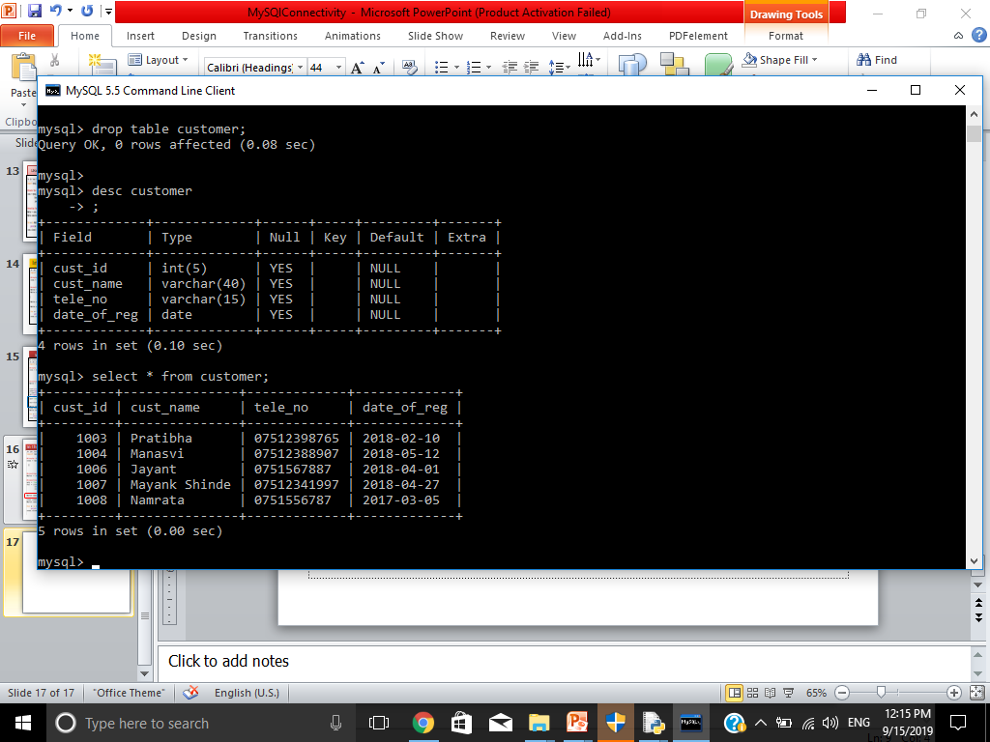
Updating Data … have a look on the table below- We are going to change the name of customer 1003 to ‘Sudha’

Slide 17
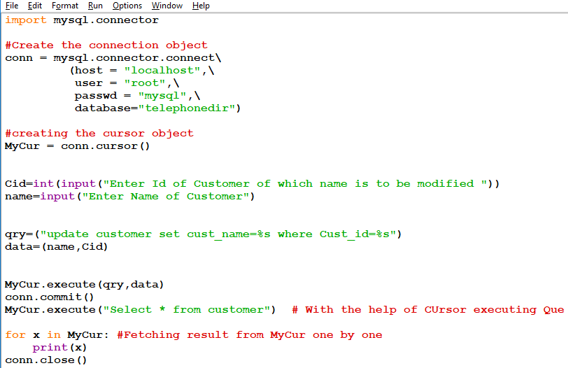
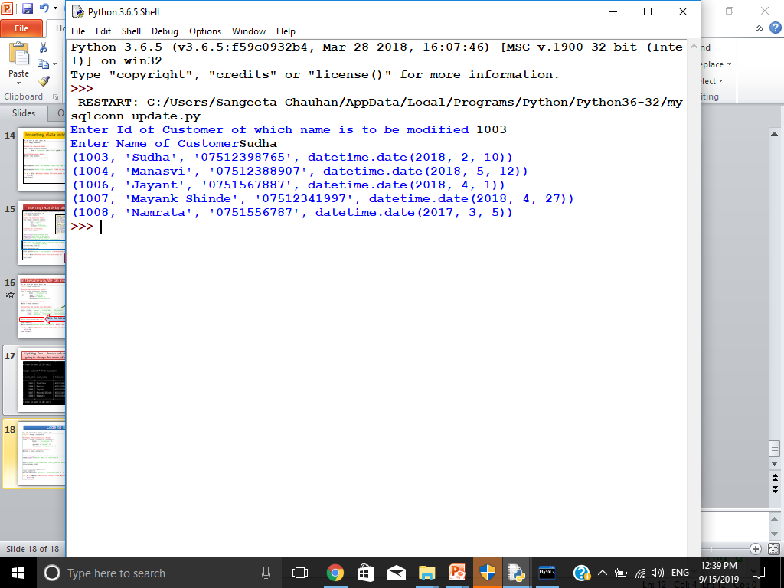
Code to update
Name of 1003 customer is changed to Sudha

Slide 18
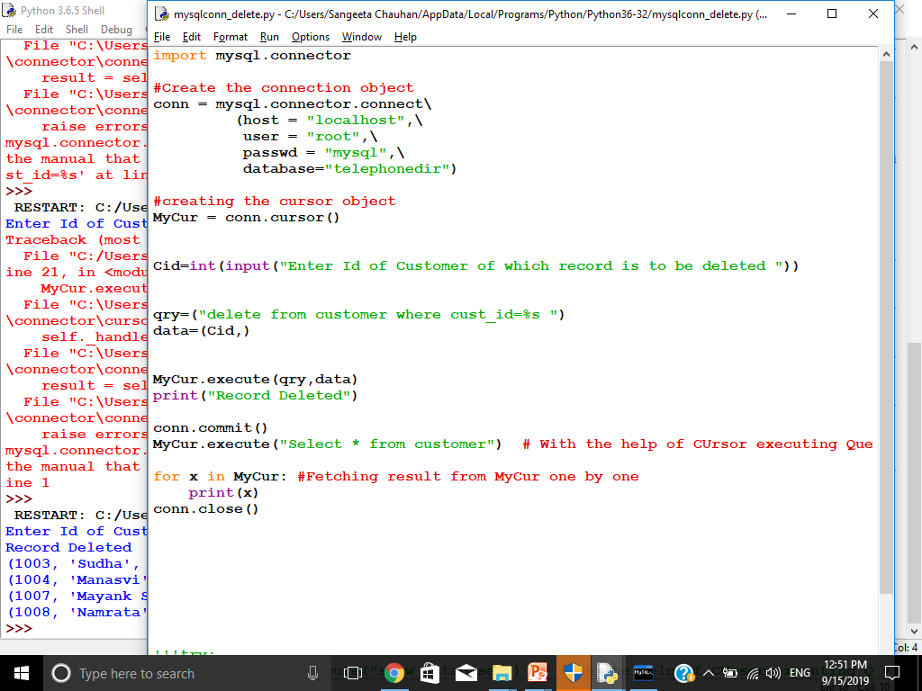
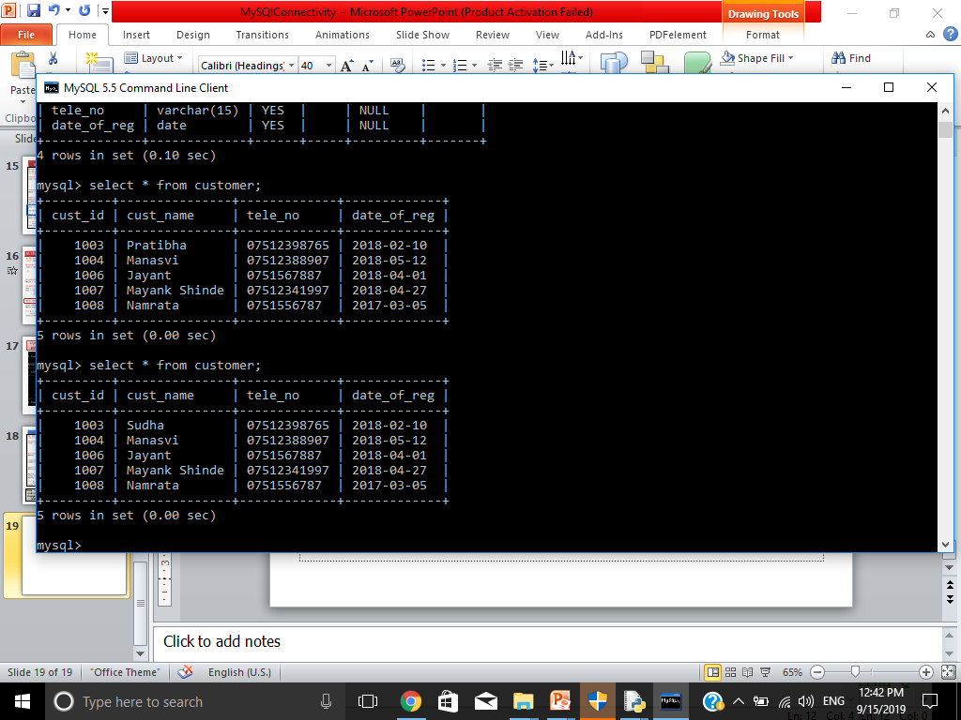
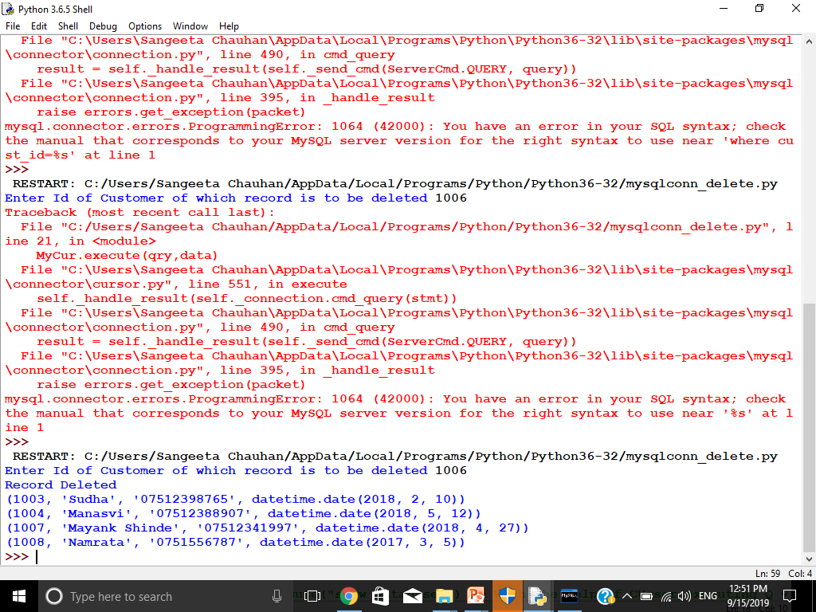
Deleting record: lets delete the record
Record with cust_id 1006 is deleted now

Slide 19
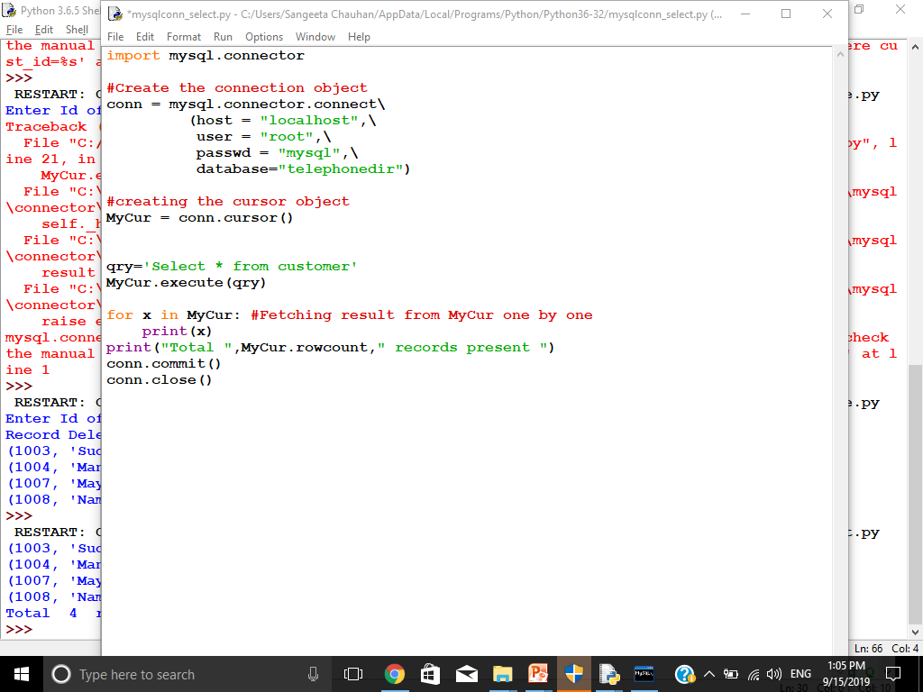
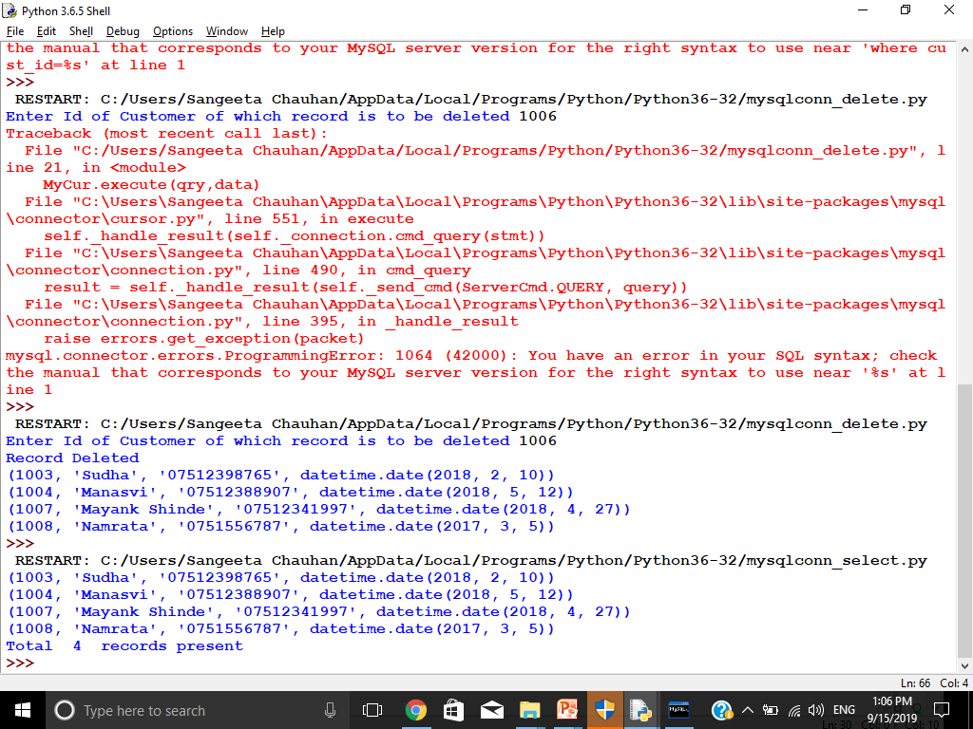
Cursor.rowcount
It will tell display no. of records fetched after running
You can Query.run this command after executing any query.
Printing no. of records

Slide 20
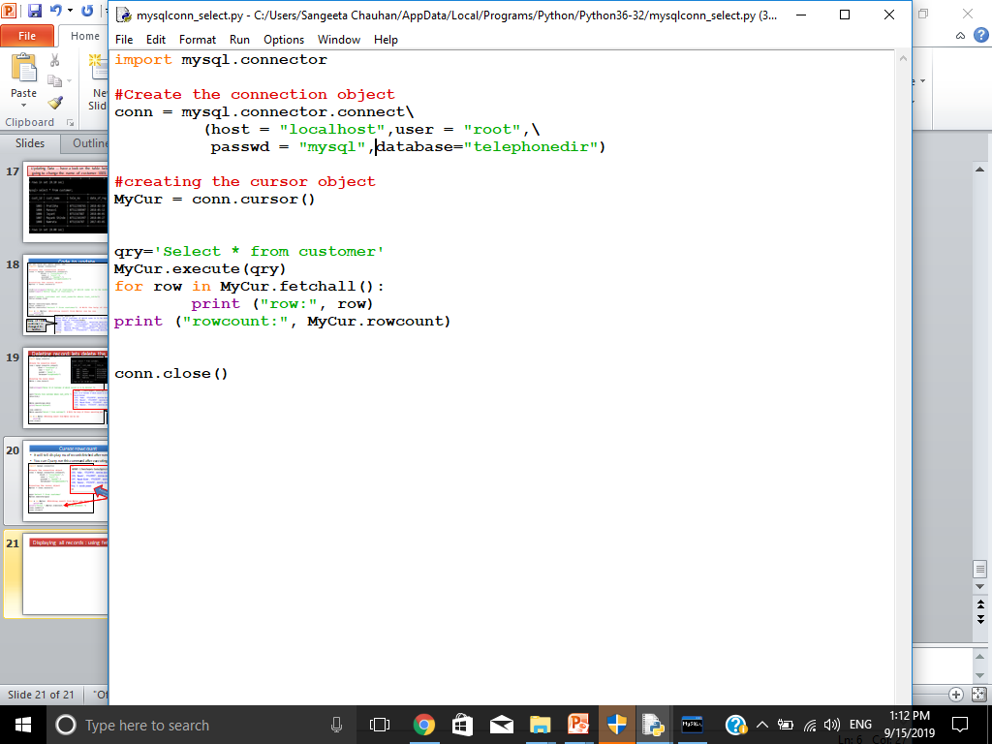
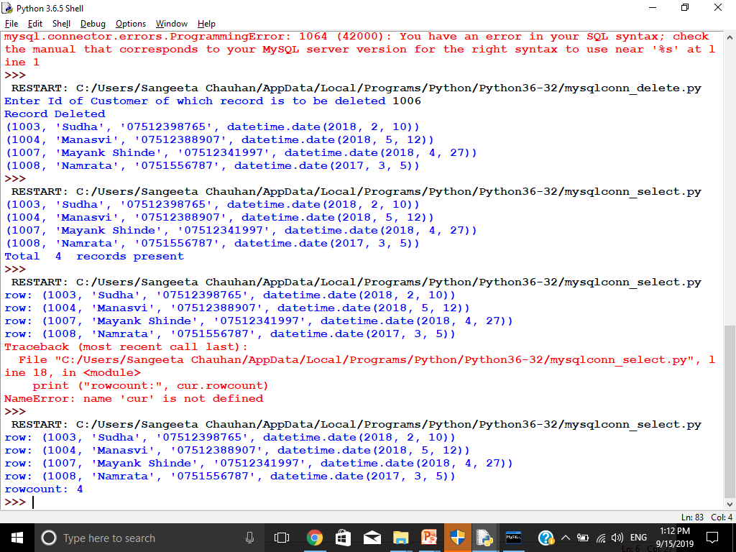
Displaying all records : using fetchall()
OUTPUT

Slide 21
Any of the following functions you can use as per your need
cursor.fetchall() fetches all the rows of a query result. It returns all the rows as a list of tuples. An empty list is returned if there is no record to fetch.
cursor.fetchmany(size) returns the number of rows specified by size argument. When called repeatedly this method fetches the next set of rows of a query result and returns a list of tuples. If no more rows are available, it returns an empty list.
cursor.fetchone() method returns a single record or None if no more rows are available.

Slide 22

For Error Handling Two more module we need to import, are:
>>>from mysql.connector import Error
>>>from mysql.connector import errorcode
MySQL connector Error object is used to show us an error when we failed to connect Databases or if any other database error occurred while working with the database.
Error expecting code must be written in try………..except block

Slide 23
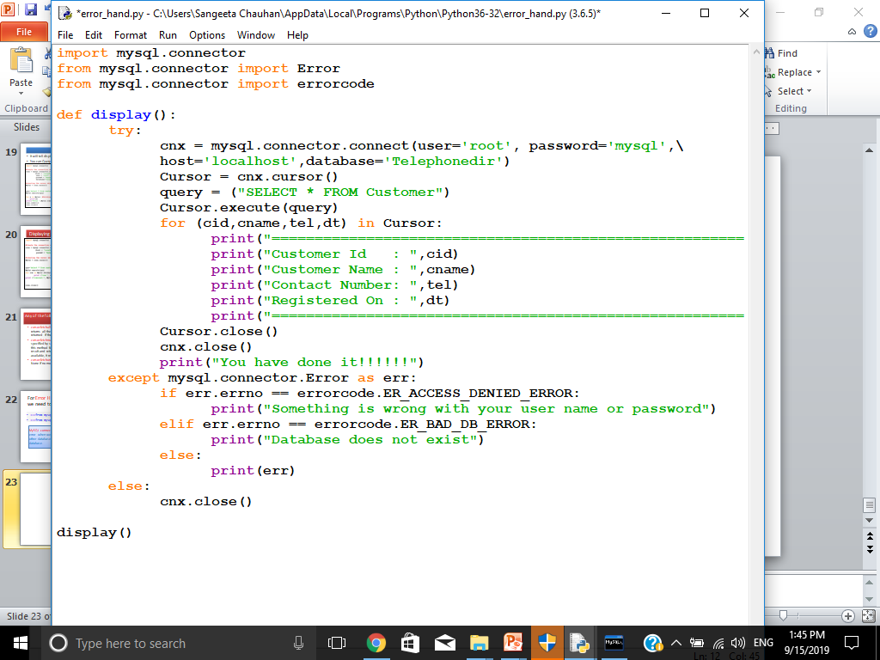
Error Handling code while displaying records

Slide 24
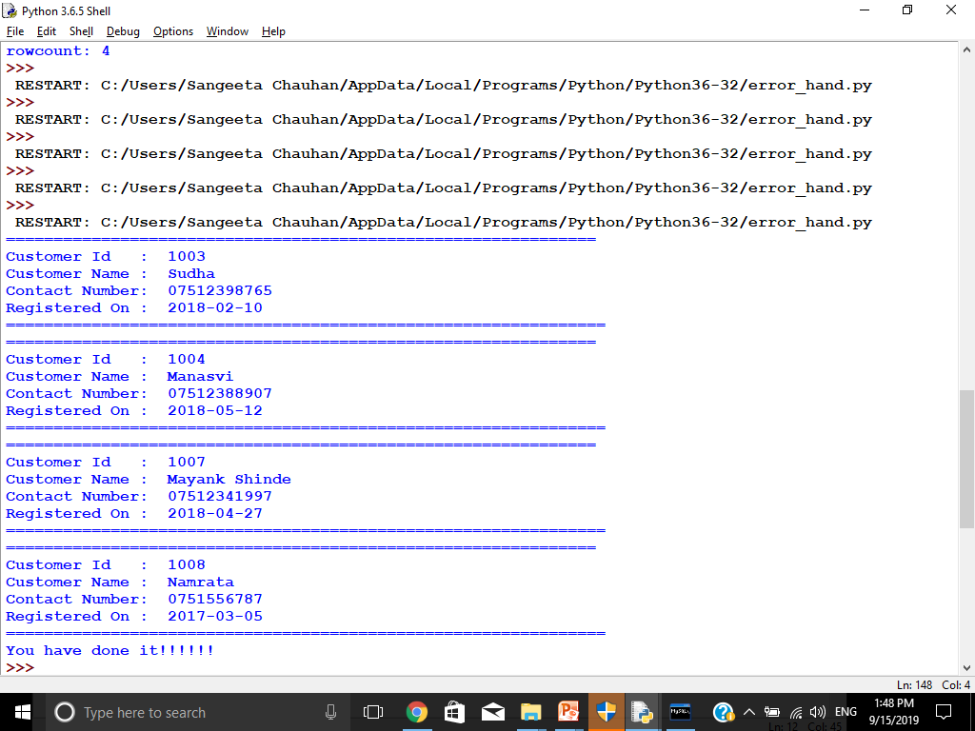
OUTPUT OF PREVIOS PROGRAM

Slide 25
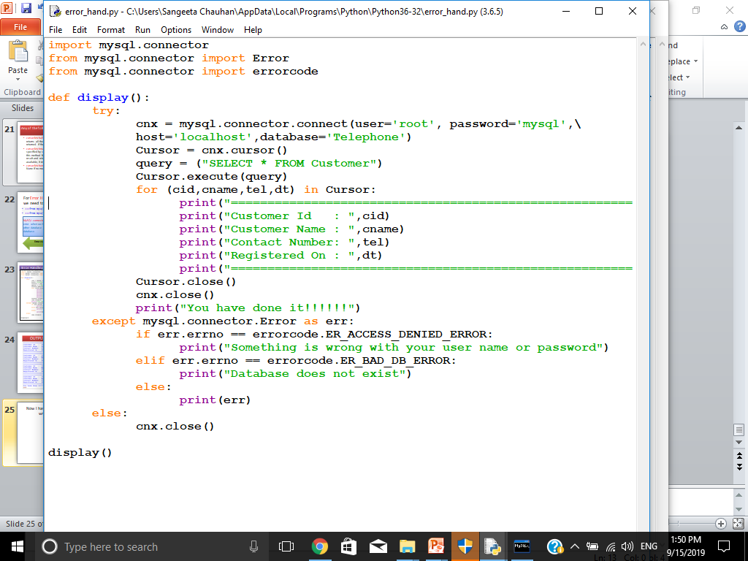
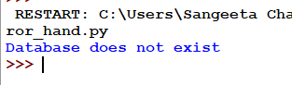
See, I have written wrong database name which is not exists
OUTPUT

